Slide 1


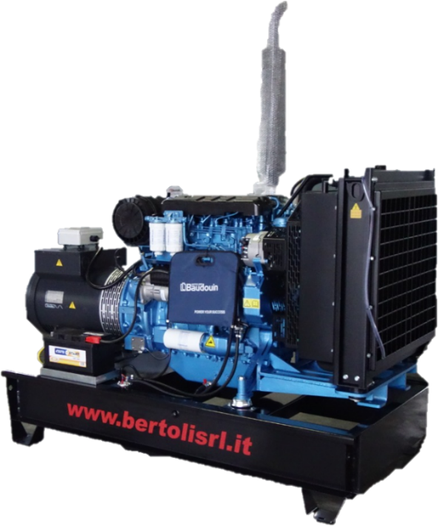




Picture may not show the actual product due to presence or absence of optional items
Generating set model
15BA/50TNE
Standard features:
Documentation:
Engine:
12V electric starting with battery
Radiator designed to work up to 50°C ambient temperature without power deration
Low oil pressure and high coolant temperature sensors
Fuel filter
Lube oil filter
Dry air filter
Protection grids for rotating parts
Electronic speed governor
Industrial muffler
Alternator:
4P, three phase, single bearing, brushless, self excited
Automatic voltage regulator, digital type
Structural steel base:
Vibration dampers between engine/alternator monoblock and the base
Fuel tank
Set mounted control panel
Generating set use and maintenance manual
Engine use and maintenance manual
Alternator use and maintenance manual
Generating set controller instruction manual
Wiring diagram
EC Declaration
Regulations and Standards:
Generating set is designed in compliance with the following regulations and standards:
ISO 8528
2006/42/EC (Machinery) and subsequent amendments
2014/30/EU (Electromagnetic Compatibility) and subsequent amendments
2014/35/EU (Low Voltage) and subsequent amendments
2000/14/EC (Noise Emission in the Environment) and subsequent amendment 2005/88/EC
EN 61439-1
Available on request:
Engine:
24V electric starting
Electronic speed governor
Oil suction pump [soundproof sets only]
Fuel transfer pump
Water pre-heating [sets in standby to the mains only]
Silencer:
Residential silencer for open sets designed to reduce noise level by ≤ 28 / 30 dB(A)
Residential silencer for open sets designed to reduce noise level by ≤ 18 / 20 dB(A)
Control panel:
Remote ATS system for set mounted automatic control panel
AMF+ATS control panel
Differential protection
Coolant temperature reading
Oil pressure reading
Enclosure:
Soundproof canopy designed to achieve 70±3 dB(A) @ 7m
Soundproof canopy designed to achieve 75±3 dB(A) @ 7m
Low speed trailer
Generating set designed and manufactured in facilities certified to ISO 9001
Bertoli s.r.l. - 43013 - Langhirano (PR) - Italy - via Tomasicchio 3/5 +39 0521 861386 - +39 0521 858265 - info@bertolisrl.it - www.bertolisrl.it

Slide 2

Generating set
Engine
Prime power output (PRP) | 45/ 36 (KVA / kW)
Standby output (STP) | 50/ 40 (KVA / kW)
Power factor | 0.8
Voltage | 400 (V)
Frequency | 50 (Hz)
Rated speed | 1500 (RPM)
Current @ PRP | 65,02(A)
Manufacturer | BAUDOUIN
Model | 4M06G50/5
Emissions | Stage 0
Cooling | Water
Aspiration | Turbocharged
Combustion system | Direct injection
Compression ratio | 17,5 : 1
Governor | Electronic
Cycle | Diesel, 4 strokes
Cylinders (number/configuration) | 4L
Bore x Stroke | 89x92 (mm)
Displacement | 2,3 l
Standby mechanical power | 40 kWm
Alternator | 35A / 12V
Starter motor | 3,7 kW / 12V
Recommended lube oil | ACEA E3-E5
MAX oil capacity | 11,5 l
Coolant capacity (engine + radiator) | 9,4 l
Oil consumption (% of fuel) | ≤ 0,4
Fuel consumption
Fuel | Diesel EN590
Fuel tank capacity | 100 l
Autonomy @ 75% of PRP | approx 14 h
Consumption @ full load | 9,5 l/h
Consumption @ 75% of PRP | 7,0 l/h
Consumption @ 50% of PRP | 4,7 l/h
General features
Battery capacity | 1 x 100 Ah
Voltage | 12 Vdc
Cooling fan air flow | 1,8 m³/sec
Air consumption @ PRP | 170 m³/h
Exhaust gas flow (max) | 211 Kg/h
Exhaust gas temperature (max) | 504 °C
Alternator
Manufacturer | Mecc Alte
Model | ECP32-2S/4 C
Rated power | 45 kVA
Insulation class | H
Mechanical protection | IP23
Regulator | DSR, digital
Accuracy | ±1 %
Execution | Brushless
Efficiency at full load | 88,3 %
Short circuit current | >300 %
Overload per 20 sec | 300 %
Waveform Distortion (THD) at full load (LL/LN) | 1,8 / 1,9 %
MAX Overspeed | 2250 RPM
Air flow | 15,7 m³/min
Approx overall dims and weight
L (cm) | (W) (cm) | H (cm) | Weight (Kg)
118 | 64 | 78 | 285
Standard operating environmental conditions
Temperature | 25°C
Barometric pressure | 100 kPA
Relative humidity | 30%
Rating definitions
Prime Power (PRP) | Prime power is the maximum power available with varying loads for an unlimited of hours. The average power output during a 24h period of operation, must not exceed 80% of the declared primo power between the prescribed maintenance intervals at standard environmental conditions. A 10% overload is available for 1h every 12h of operation.
Standby Power (STP) | Stand-by power is the maximum power available for a period of 500h/y with a mean load of 90% of the declared stand-by power. No overload is permissible for this use.
Bertoli s.r.l. - 43013 - Langhirano (PR) - Italy - via Tomasicchio 3/5 +39 0521 861386 - +39 0521 858265 - info@bertolisrl.it - www.bertolisrl.it

Slide 3

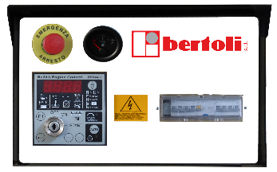
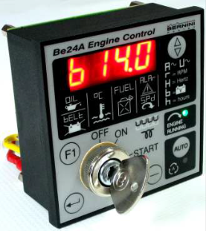
Manual control panel
Set mounted
4P magneto-thermal circuit breaker
BE24A Plus digital controller
Fuel level gauge
Emergency stop push button
Autostart control panel
Set mounted
4P magneto-thermal circuit breaker
BE24A Plus digital controller
Fuel level gauge
Automatic battery charger
Emergency stop push button
Arranged for remote transfer switch
Picture may not show the actual product due to presence or absence of optional items
BE24A
Digital controller for manual and automatic management of generators.
Front Panel features:
2 LEDs
three position key selector (ON / OFF / START)
6 push-buttons
indication of the main engine alarms
4 digit display showing engine
generator alarms and parameters
Parameters displayed:
Generator:
Voltage
Frequency
current
Engine:
battery voltage
charger alternator voltage
running hours
engine speed (RPM)
Automatic shutdown on low oil pressure, high engine temperature, charge failure, low fuel level
In addition to above alarms, the display can show following faults:
external emergency stop
belt break
over-/under frequency
over-under voltage
failed start
over-under speed
overload
memory failure.
Available on request:
Picture may not show the actual product due to presence or absence of optional items
Socket panel (manual control panel only)
1 EEC socket 2P+T 230V 16A
1 EEC socket 3P+T+N 400V 16A
1 EEC socket 3P+T+N 400V 32A
RCCB circuit breakers
Bertoli s.r.l. - 43013 - Langhirano (PR) - Italy - via Tomasicchio 3/5 +39 0521 861386 - +39 0521 858265 - info@bertolisrl.it - www.bertolisrl.it

Slide 4
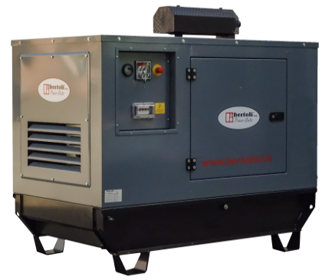
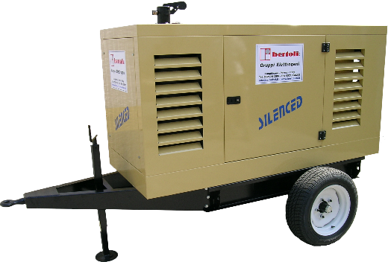
Soundproof canopy
Noise level achieved : 75 ± 3 dB(A) @ 7 m measured in open space
Sturdy unit construction in electrowelded steel sheet
Sound absorbing lining of unalterable and a
dequately thick materials
Ventilation silencers made up of sound-absorbing baffles
Recessed knobs with lock
Sealing strip on the door shutters ensure an
excellent acoustic and water proofing;
Hinges fastened with screws
Hinged window for electric board, made up of safety
glass, internal glass holding frame, outer boarder seal
Appropriate paintings for indoor and outdoor
installation and finishing with RAL epoxy painting
Rainproof gratings on the ventilation openings
Exhaust silencers
Approx overall dimensions and weight
L (cm) | W (cm) | H (cm) | Weight (Kg)
250 | 100 | 175 | 1020
Trailer for slow towing
Single axle trailer with 2 wheels positioned at the sides.
Fix rigid draw bar complete with towing eye suitable for standard balls (Ø = 50 mm)
Front stabilizer, adjustable in height
Approx overall dimensions and weight
Picture may not show the actual product due to presence or absence of optional items
L (cm) | (W) (cm) | H (cm) | Weight (Kg)
Technical data are not binding.
They may be changed for technical improvements without prior notice
Bertoli s.r.l. - 43013 - Langhirano (PR) - Italy - via Tomasicchio 3/5 +39 0521 861386 - +39 0521 858265 - info@bertolisrl.it - www.bertolisrl.it

