Slide 1
RECONSTRUCTION OF UKRAINE
I am the author and source of the events that happen around me

Slide 2
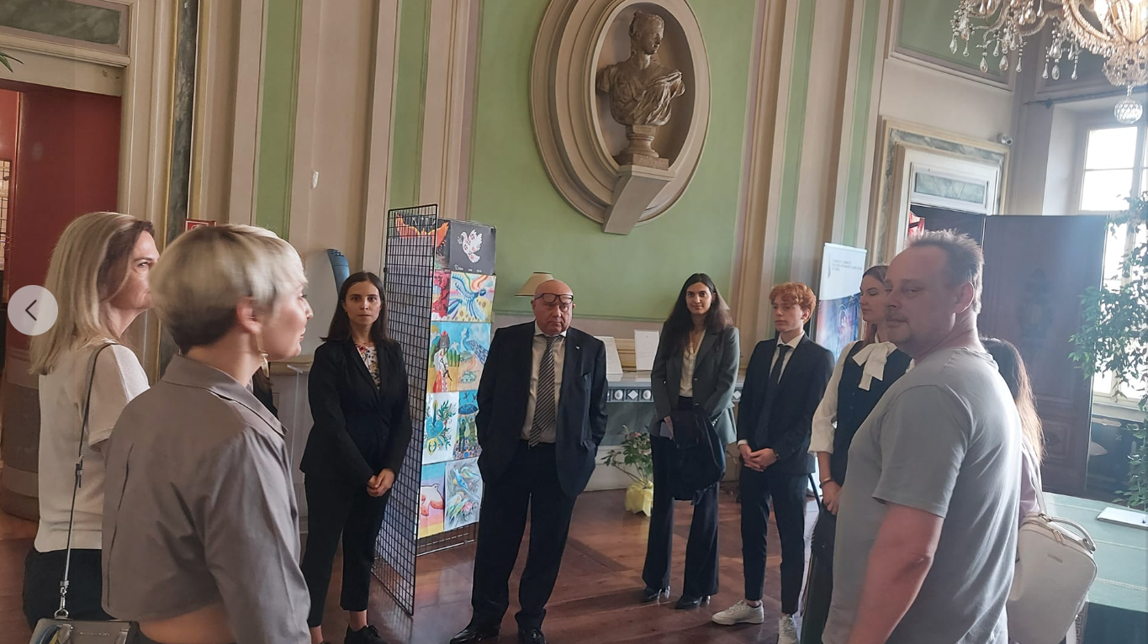
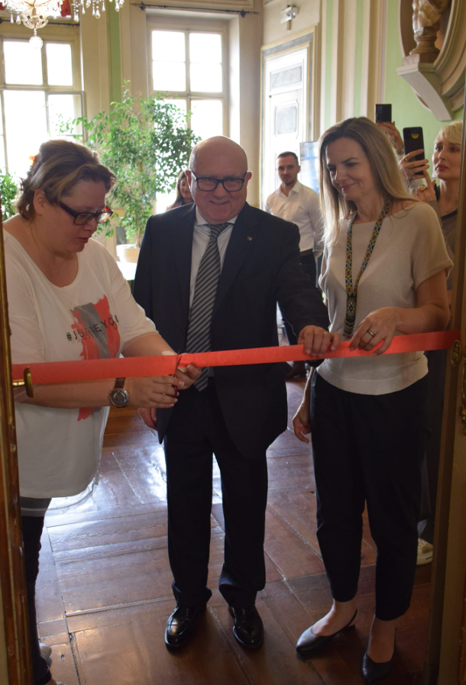

Slide 3
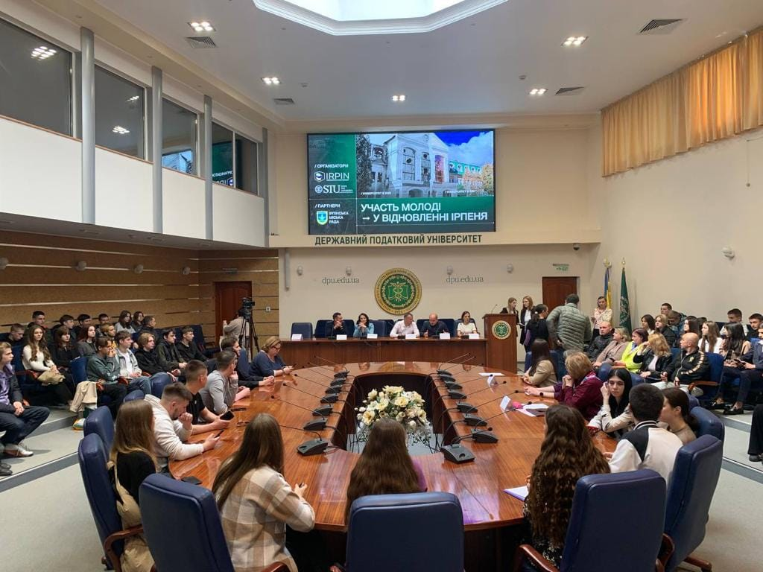
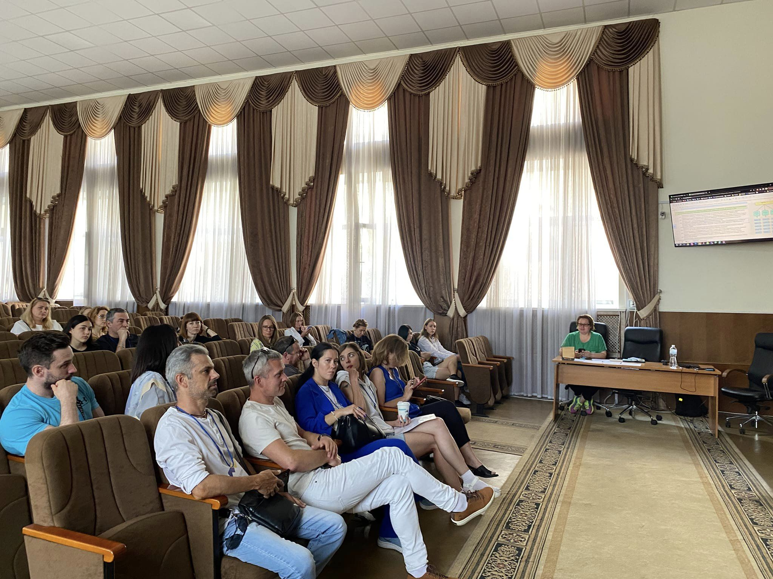
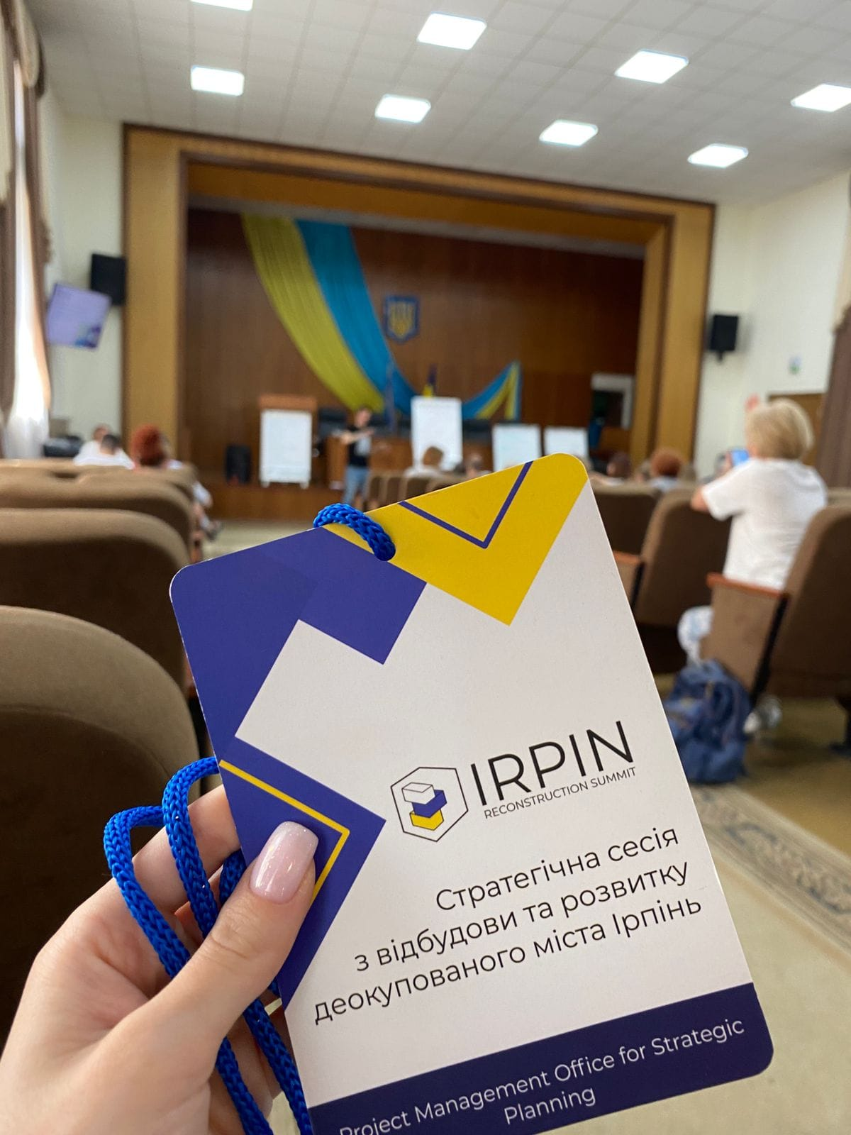
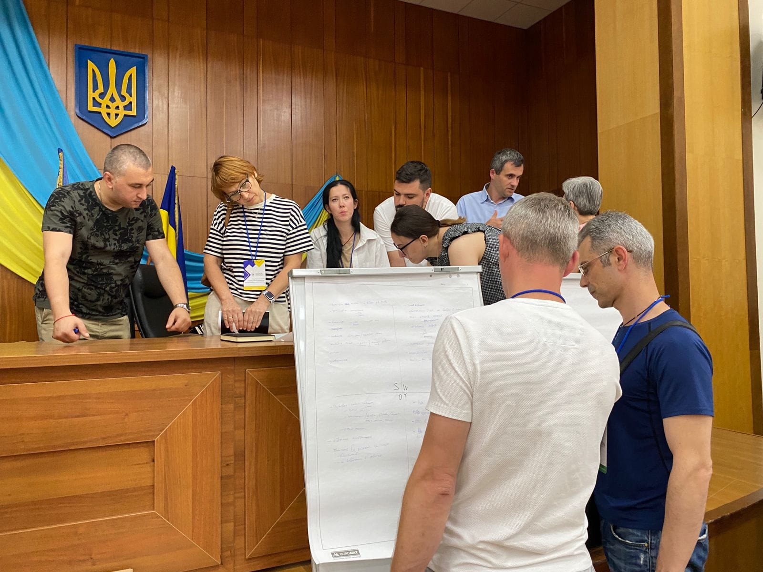
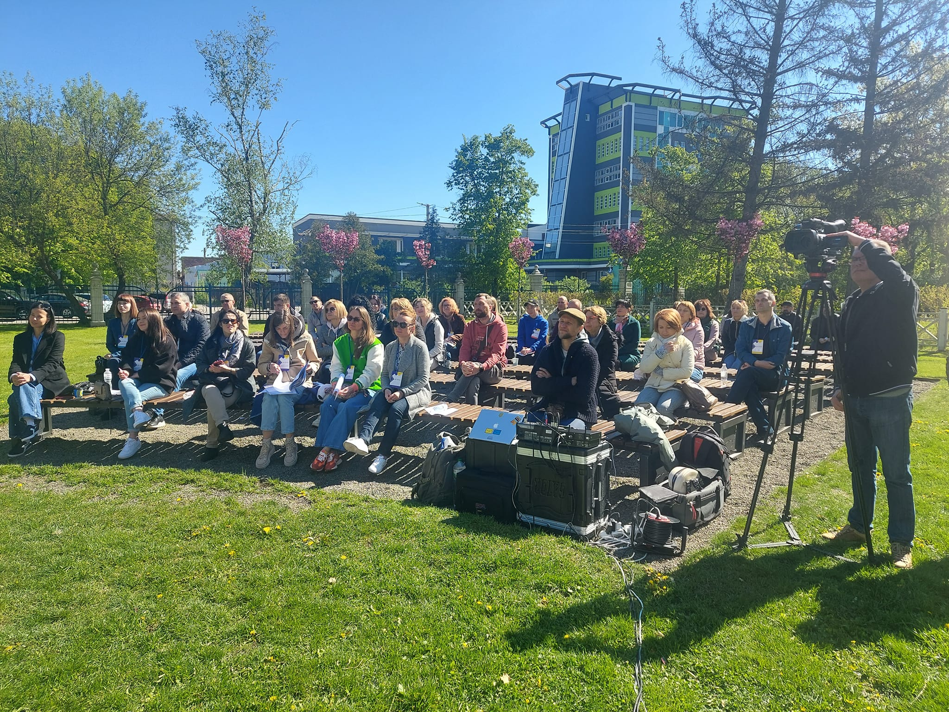
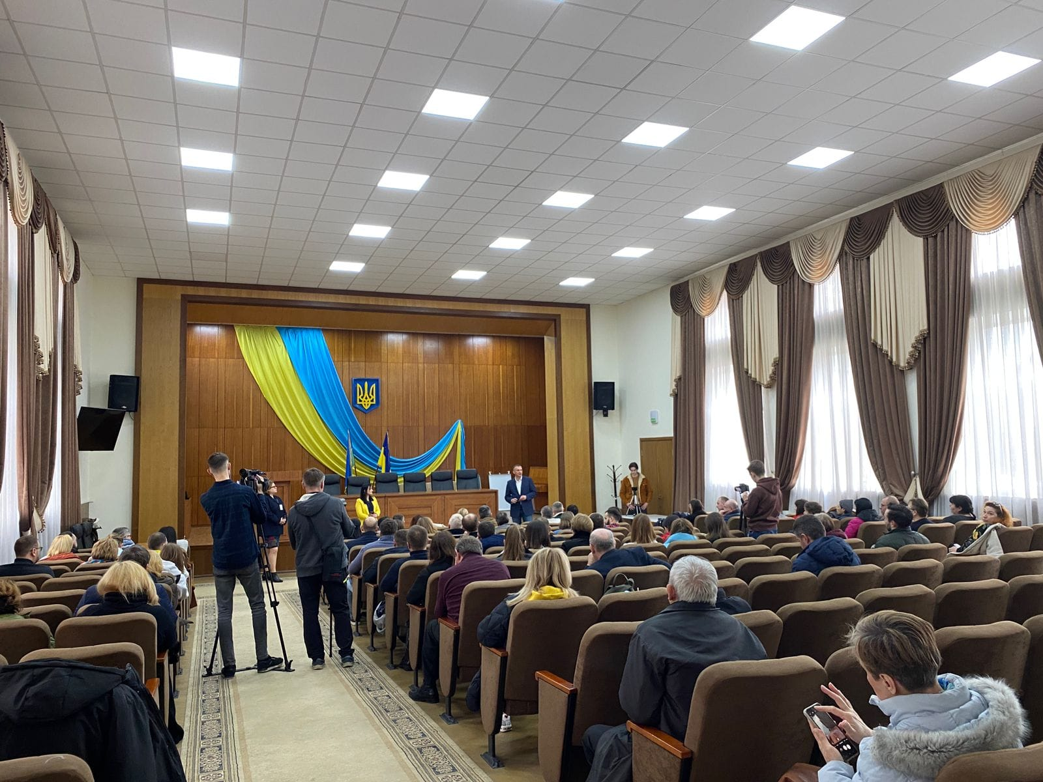
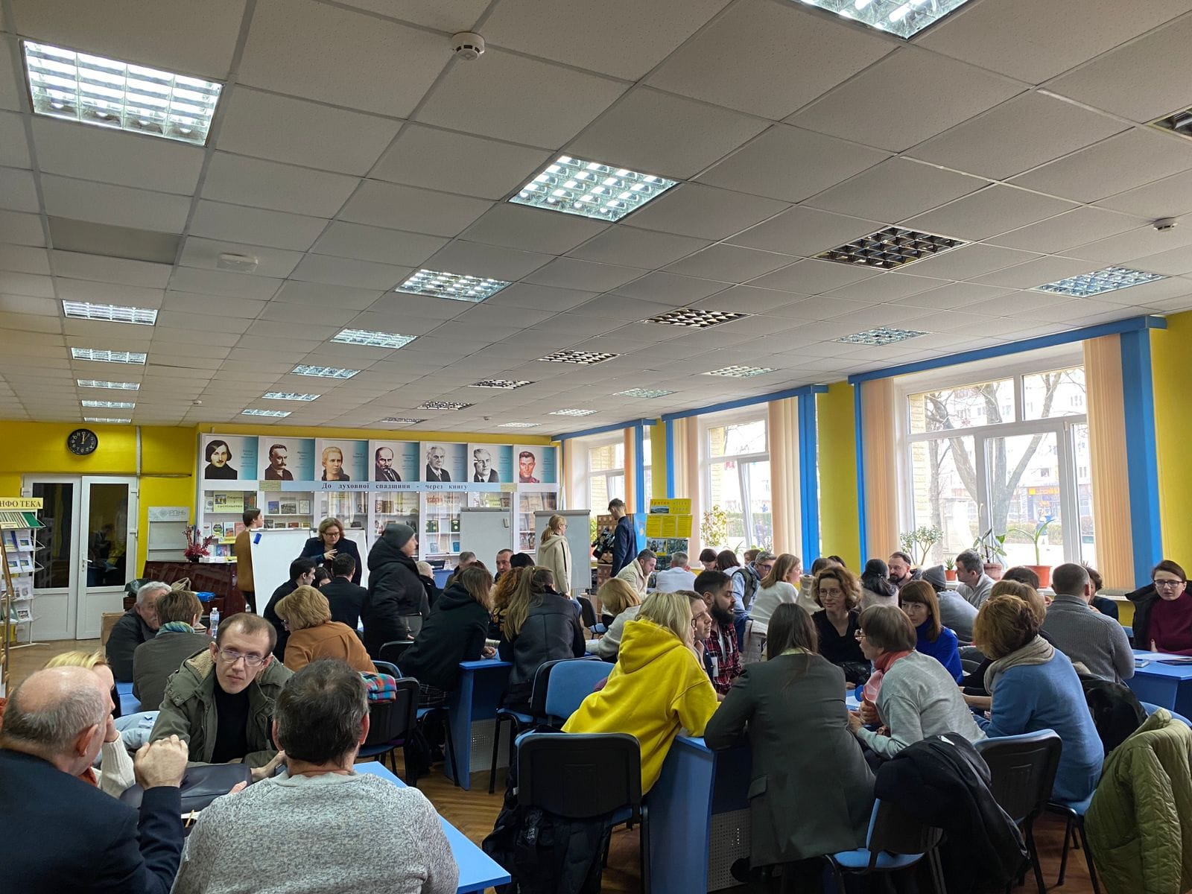
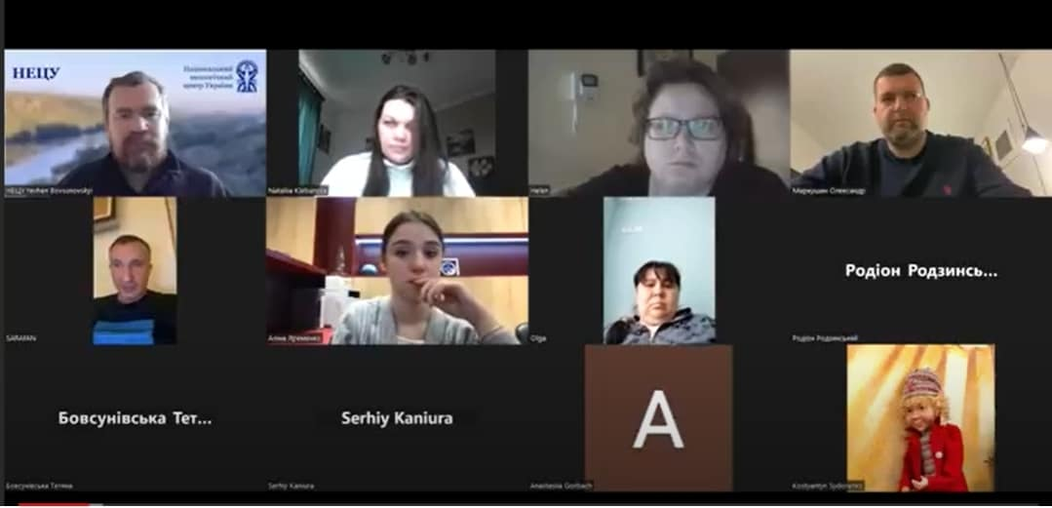

Slide 4
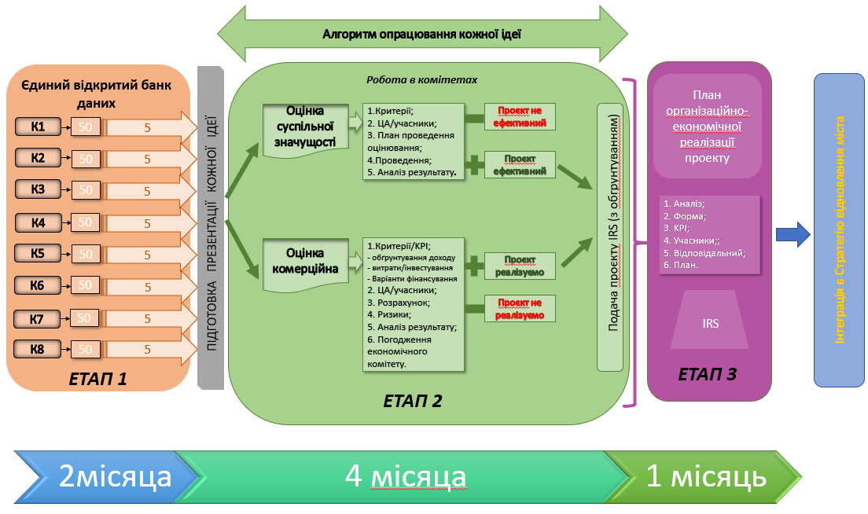

Slide 5
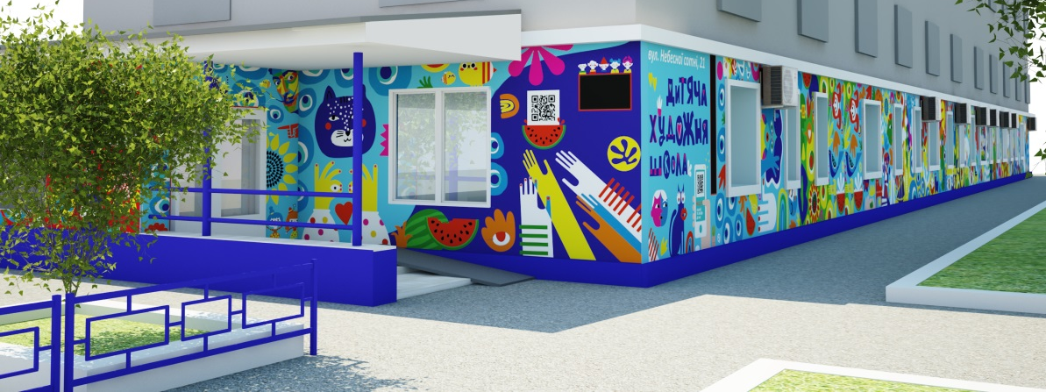
EDUCATIONAL AND AESTHETIC COMPLEX "ART SCHOOL«
м. KHERSON, UKRAINE.
Until 24.02.2022:
Enrollment - 850 studentsStaff
- 35 teachers 28 employees
Today, the school operates remotely. Students join the school from Kherson, 40 cities of Ukraine, and 30 countries.
After the war, Kherson could become a center of Ukrainian design in southern Ukraine. The development of design based on the potential of the region's multiculturalism will lead to the creation of unique products and authentic brands, promote industrial development, the emergence of competitive enterprises and new jobs in Ukraine.

Slide 6
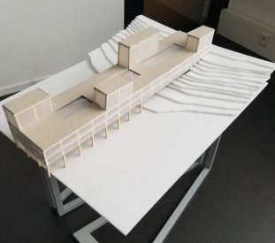
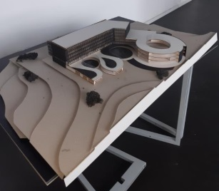
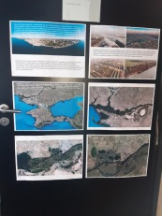
NEW BUILDING OF THE ART SCHOOL OF KHERSON,
project proposals of students of the Faculty of ArchitectureCzech Technical University in Prague
proposed locations
project proposals

Slide 7
THANK YOU FOR YOUR ATTENTION !
Do you have any questions?
vitaukritalia@gmail.com
+38 095 280 47 52
+39 392 338 78 88
https://www.facebook.com/vitaukritalia

