Slide 1
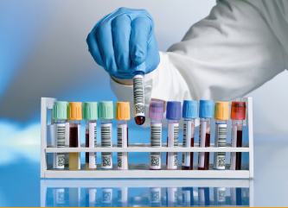
We have been with you since 2012!
More than 10 years of experience and quality!
The label "Made in Odesa region" dated 02.11.2021. 100% regional origin of the company
Certificated company by ISO 9001:2015 quality management in the field of laboratory services, international certification since 2020
In July 2023, NAAU was audited for compliance with the requirements of EN ISO 15189:2015 (Medical laboratories - requirements for quality and competence
A licensed, certified and accredited medical laboratory with its own modern production complex and more than 10 years of experience, located in the heart of Odesa at 24 Bohdana Khmelnytskoho Street, with more than 30 lab.offices in Odesa and Odesa region.
artmediuz@gmail.com

Slide 2
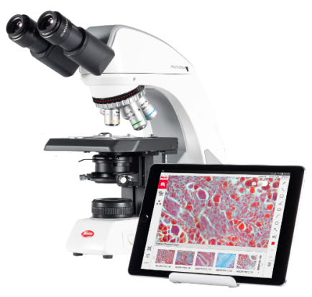
The laboratory complex of the enterprise is designed to conduct general clinical, biochemical, immunological, virological laboratory tests using various methods and modern technologies
The laboratory is a leader and has unique methods for determining blood coagulation disorders (hemostasis). The only laboratory that deals with the problems of thrombophilia and pulmonary thrombosis, including miscarriage and IVF.
The laboratory has unique methods and conducts more than 300 types of laboratory tests using the most modern methods and equipment.
artmediuz@gmail.com

Slide 3
Technology facts:
We use technologies, equipment, and reagents from the world's best production leaders. Successfully combining them to realize all the advantages and quality of the equipment for specific tasks. Different manufacturers are the world’s leaders in each individual area. Thus, we have the best technologies in all our areas
artmediuz@gmail.com

Slide 4
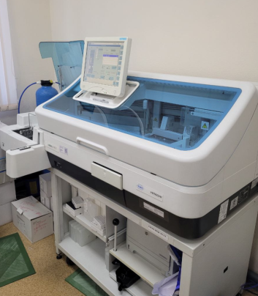
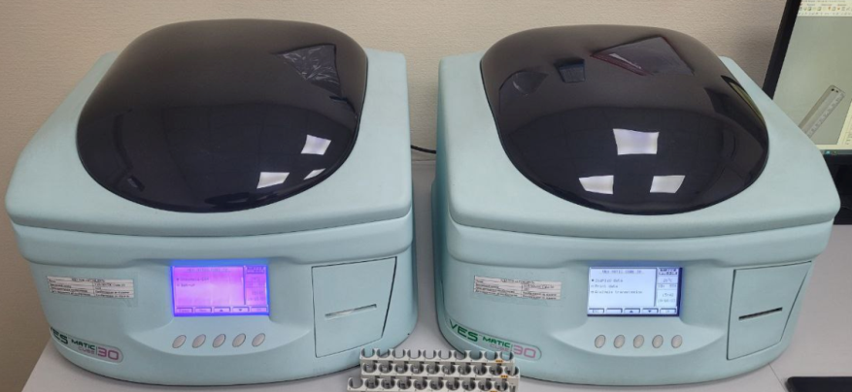
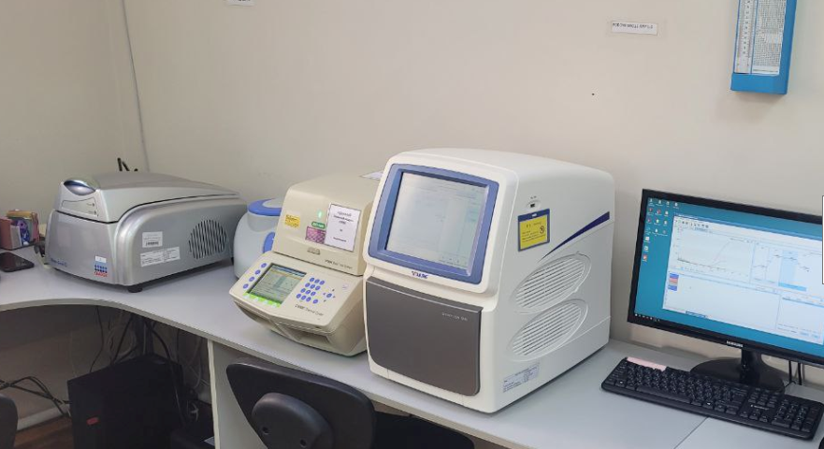
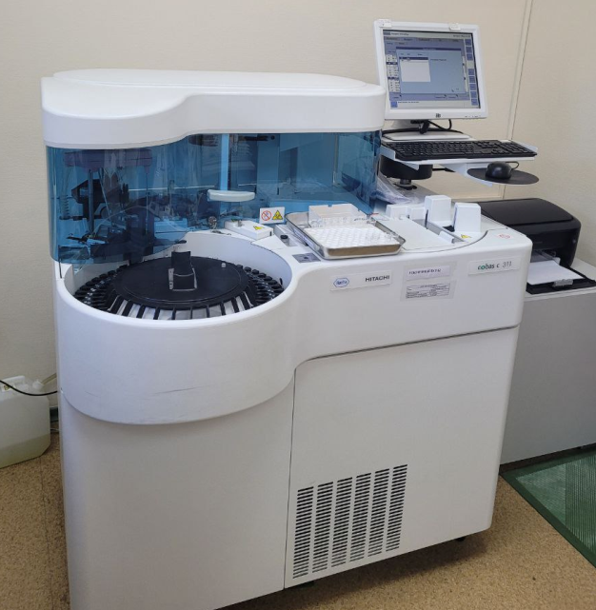
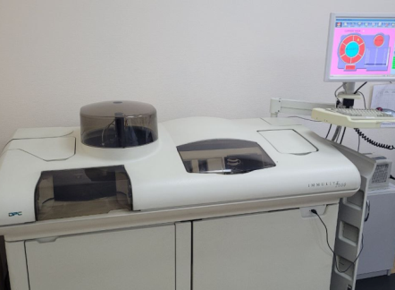
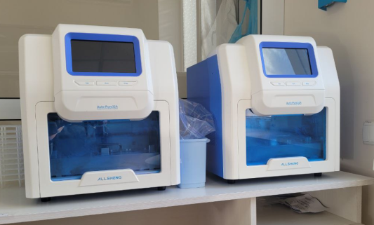
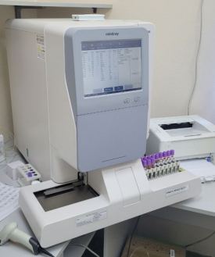
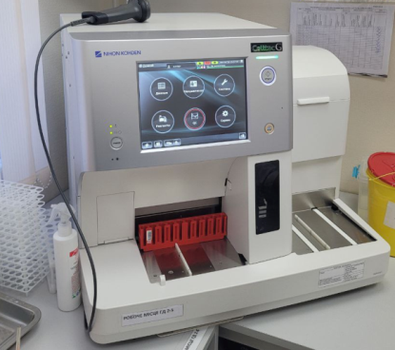
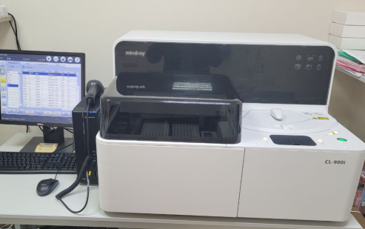
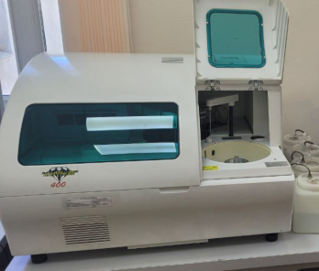
Visual facts:
All equipment is combined with the laboratory information system into a powerful software package with unique sample marking, which makes it possible to automate processes as much as possible and eliminate discrepancies or errors
artmediuz@gmail.com

Slide 5
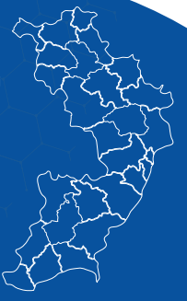
Our offices in the region
Map of Odesa region is showing the presence of laboratory departments
These are 30 laboratory offices, which are located in the most densely populated and economically developed areas of the region
Mykolaev region
Good logistic chain of delivery of biological material allows to quickly conducting laboratory tests on the same day.
12
2
3
artmediuz@gmail.com

