Slide 1
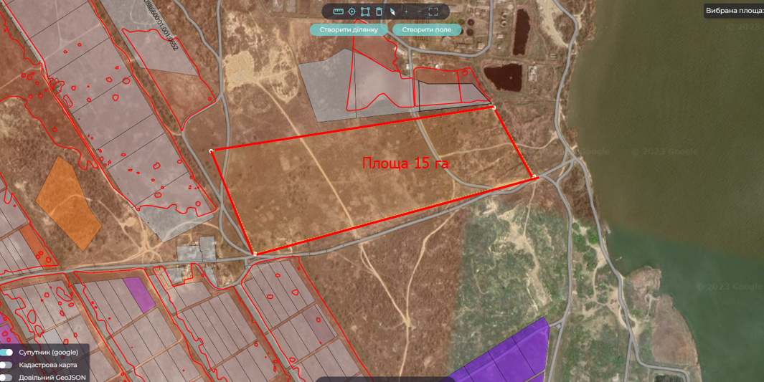
Location
Project initiator
Shabo rural territorial community
Odesa region, Shabo rural territorial community
Salgany village
In borders of settlement
Shabo village council
Population: 16 872 people
Community area: 631 sqю.km
Project advantages
Transportation
Support of the village council in the implementation of the project
Privileges for investor: benefits for plot renting
Up to the border of the residential zone – 0,2 km
To the railway station Shabo - 2 km
To the district center – 5 km
To the regional center – 80 km
To the national state highway – 2 km
To the international highway – 20 km
Land plot for the construction of solar power plants
Property
Funding sources
Municipal property
Terms of transfer - rent
International and state investments, community funding
Social and economic effect
Area
15 hectares
Attraction of investments
Creating of new working places
Increasing the competitiveness of the community
Development of scientific, production and market infrastructure
Development of green energy
Project purpose
For the construction of solar power plants, industrial enterprises
Technical infrastructure
To the gas pipeline – 0,3 km
To the power line (voltage 10 kW) – 0,2 km
Water supply – artesian well
To the sewerage system - 3 km

Slide 2
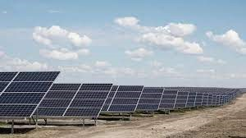
Shabo rural territorial community
Taking into account global world trends, today the Shabo territorial community has a favorable environment for the development of solar energy projects, because the most powerful and most accessible source of alternative energy is the Sun. There are free plots of land for the construction of solar power plants in the Shabo territorial community.
We invite you to participate in an exciting project of the construction of solar power plants on our excellently located plot of land. Solar energy is the future, and we are confident that together we can ensure efficient and sustainable electricity production.
Our plot of land is located in an ideal location with great solar potential and excellent conditions for the development of solar energy. We have all the necessary permits and government support to implement this project. Modern solar panels and technologies will help us make the most of solar energy and generate a stable flow of electricity.
Investment in this project will not only lead to profitability, but also contribute to the reduction of CO2 emissions and the improvement of the environment. Solar power plants are an environmentally friendly investment path to the future. Join us, and together we will turn solar energy into sustainable profit and environmental benefit for our world.

