Slide 1
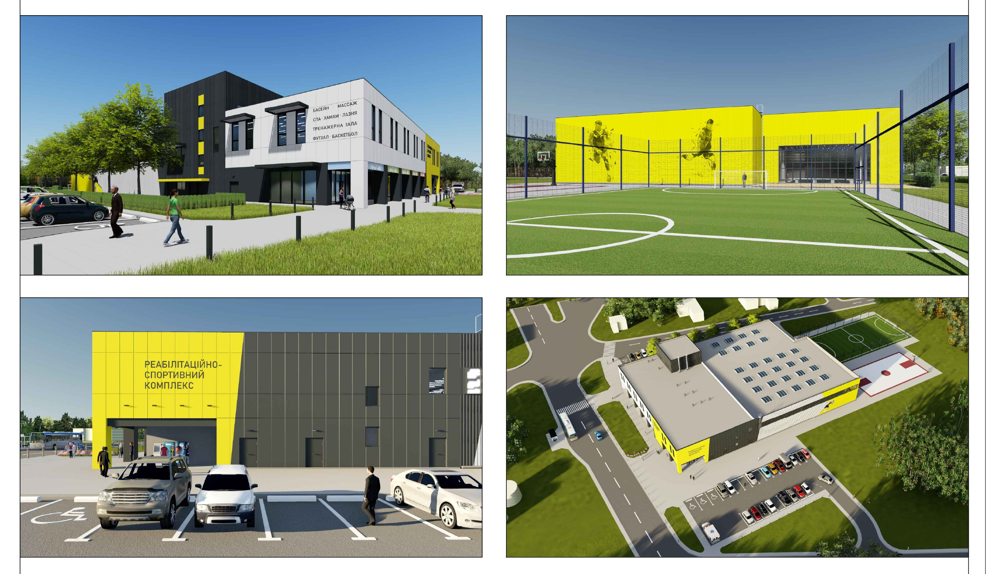
CONSTRUCTION OF A UNIVERSAL GYM AND SWIMMING POOL
INVESTMENT PROPOSAL
BILOHORODKA COMMUNITY, Kyiv region, Ukraine, 2023

Slide 2
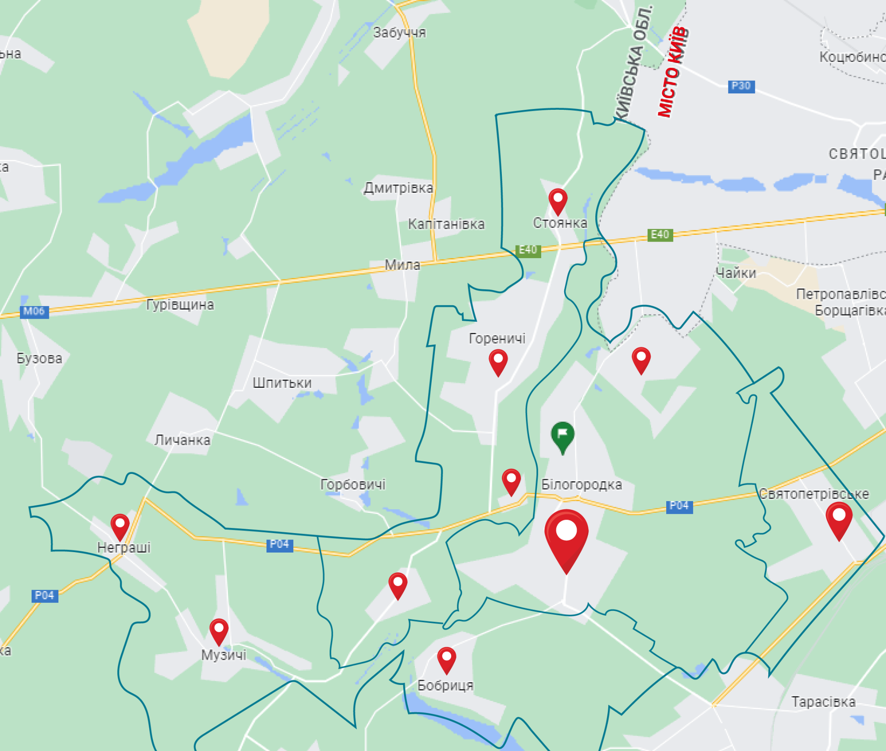
GENERAL INFORMATION
BILOHORODKA COMMUNITY, Kyiv region, Ukraine, 2023
28,8 / 53,35
5934
579
Population, thousand people, registered / actually living
Internally displaced persons
People with disabilities
151,3
Community area, square kilometers
10
Number of settlements
The administrative center
Bilohorodka

Slide 3
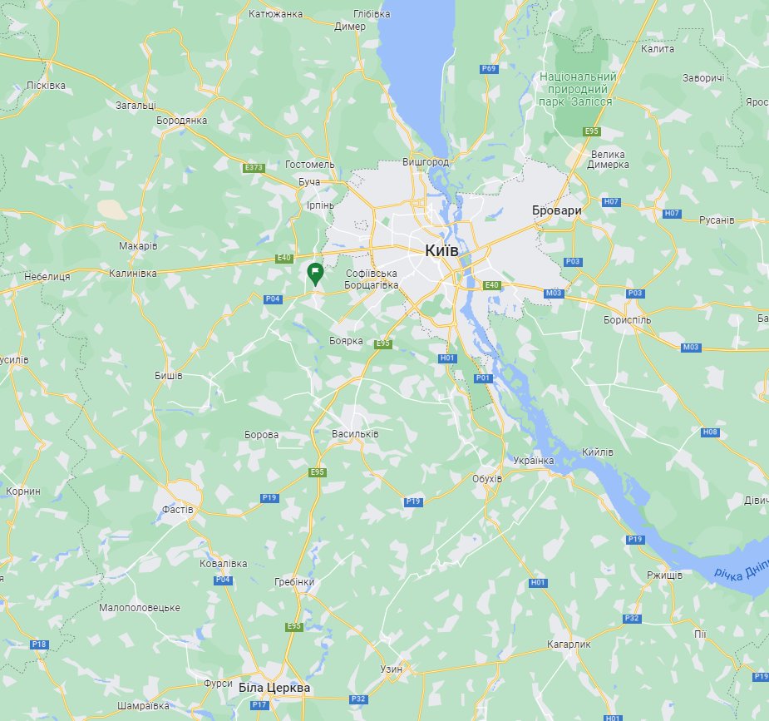
GENERAL INFORMATION
BILOHORODKA COMMUNITY, Kyiv region, Ukraine, 2023
Distances
Kyiv
15 km / 20 min
Bucha
24 km / 30 min
Vyshneve
12 km / 15 min
Bila Tserkva
80 km / 1 hr.
Boryspil
65 km / 1 hr. 10 min
Yahodyn border crossing point (PL)
500 km / 6 hr.
Rava-Ruska border crossing point (PL)
565 km / 6 hr.
Notes:
ЯКІ НАСЕЛЕНІ ПУНКТИ ДОДАТИ?

Slide 4
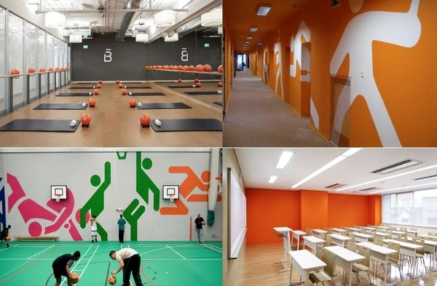
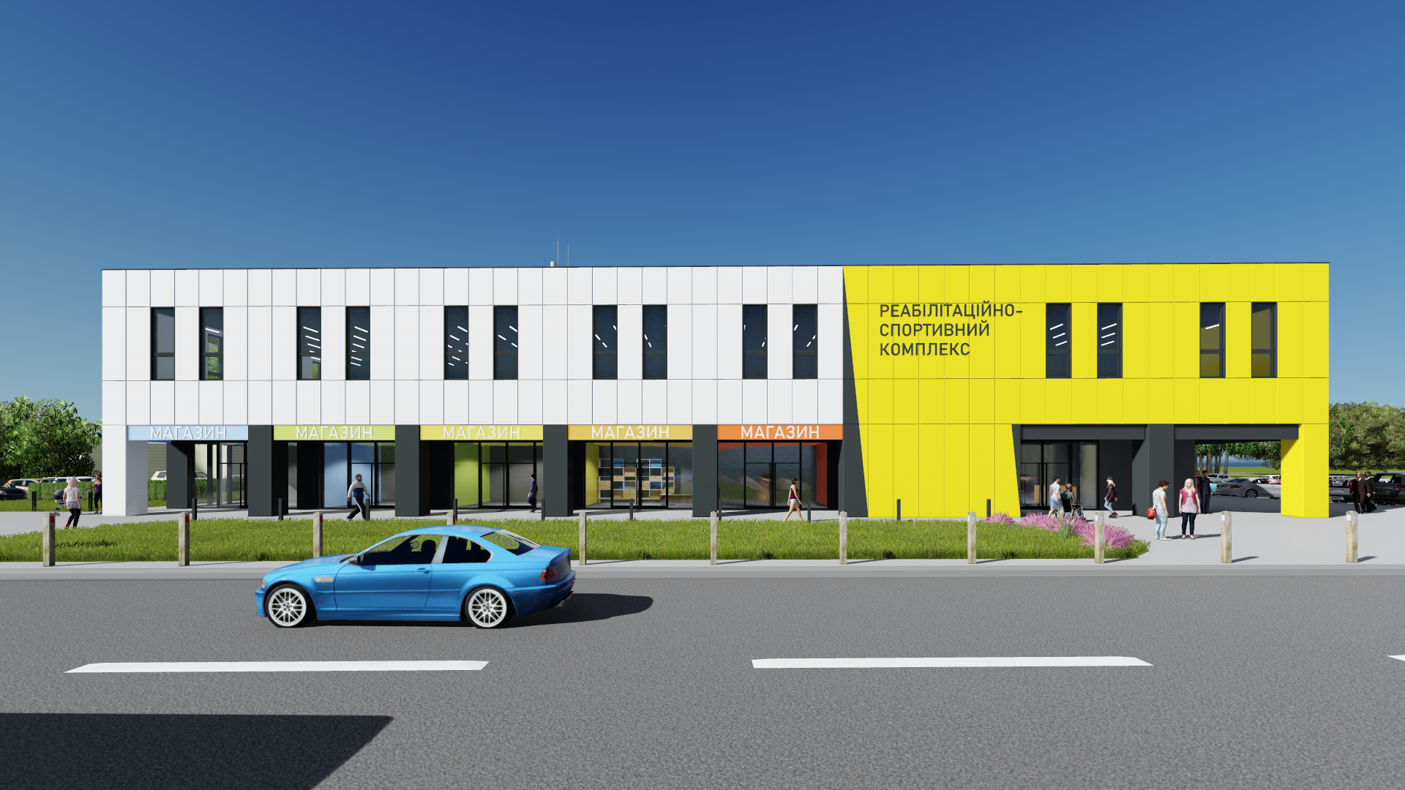
CONSTRUCTION OF A UNIVERSAL GYM AND SWIMMING POOL
LAND PLOT
Location: Bilohorodka village, (asphalt road).
Area: 1 hectare.
Ownership: communal.
Purpose: for construction and maintenance of sports infrastructure.
Design and estimate documentation prepared
CHARACTERISTICS OF THE LAND PLOT AND COMMUNICATIONS
Distance to electricity, water, and gas supply networks is 50 meters.
Financing of the development of the project of external networks and the work on connecting the future sports facility to communications at the expense of the local budget.
Willingness to consider standard solutions for sports facilities.
+38 067 457 20 37 bilogorod.rada@gmail.com https://bilohorodka.org.ua/ facebook.com/groups/bilohorodka/
BILOHORODKA COMMUNITY, Kyiv region, Ukraine, 2023

Slide 5
CONSTRUCTION OF A UNIVERSAL GYM AND SWIMMING POOL
Functional purpose:
Center for health, sports and leisure
Rehabilitation center
A training facility for students of the municipal sports facility and young athletes attending sports clubs in Bilohorodka and neighboring communities
Organizing various sports competitions at local, regional and international levels.
Community center for educational and cultural events, seminars, and trainings
ESSENCE
+38 067 457 20 37 bilogorod.rada@gmail.com https://bilohorodka.org.ua/ facebook.com/groups/bilohorodka/
BILOHORODKA COMMUNITY, Kyiv region, Ukraine, 2023

Slide 6
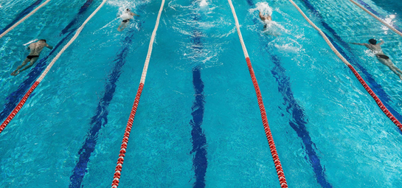
CONSTRUCTION OF A UNIVERSAL GYM AND SWIMMING POOL
Target audience (customer groups):
people who have suffered psychological and physical trauma due to the war and need recovery (military personnel, internally displaced persons, families of the deceased, people under occupation)
people with disabilities;
athletes of the Bilohorodka community and neighboring communities;
pupils of municipal sports institutions who attend sports sections; physically and socially active youth;
elderly people.
+38 067 457 20 37 bilogorod.rada@gmail.com https://bilohorodka.org.ua/ facebook.com/groups/bilohorodka/
BILOHORODKA COMMUNITY, Kyiv region, Ukraine, 2023

Slide 7
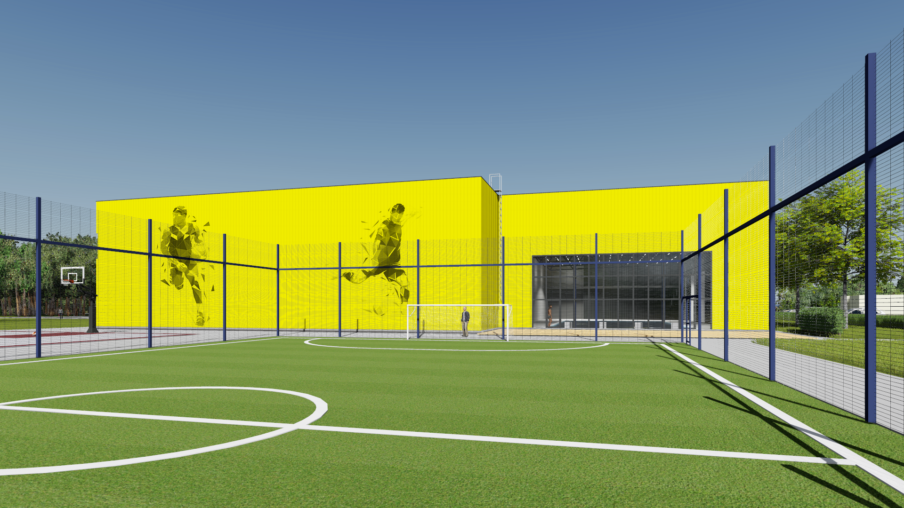
CONSTRUCTION OF A UNIVERSAL GYM AND SWIMMING POOL
football
volleyball
basketball
swimming
gymnastics taekwondo
boxing
kickboxing
tennis
table tennis
universal gym
handball
SPORTS
Rating of planned competitions: regional, national and international
Number of spectators : 600
+38 067 457 20 37 bilogorod.rada@gmail.com https://bilohorodka.org.ua/ facebook.com/groups/bilohorodka/
BILOHORODKA COMMUNITY, Kyiv region, Ukraine, 2023

Slide 8
ECONOMIC ATTRACTIVENESS FACTORS
The center of Belogorodka village, good location, convenient logistics.
Professional promotion of many sports, including Olympic sports.
Strengthening the image of the Bilohorodka community as a community with high-quality sports infrastructure.
Creation of the first rehabilitation and sports center in the community.
Spreading popularity for sports, health and active leisure.
Development of a municipal institution that will manage and maintain the future sports facility.
Creation of new jobs, which will have a positive impact on employment and the community budget.
Use of the facility's functional resource by non-municipal organizations on a commercial basis.
Construction using the latest energy saving technologies.
The economic activity of the facility will be aimed at creating a quality product that will develop the purchasing power of the population and attract sponsors.
FACTORS
+38 067 457 20 37 bilogorod.rada@gmail.com https://bilohorodka.org.ua/ facebook.com/groups/bilohorodka/
BILOHORODKA COMMUNITY, Kyiv region, Ukraine, 2023

Slide 9
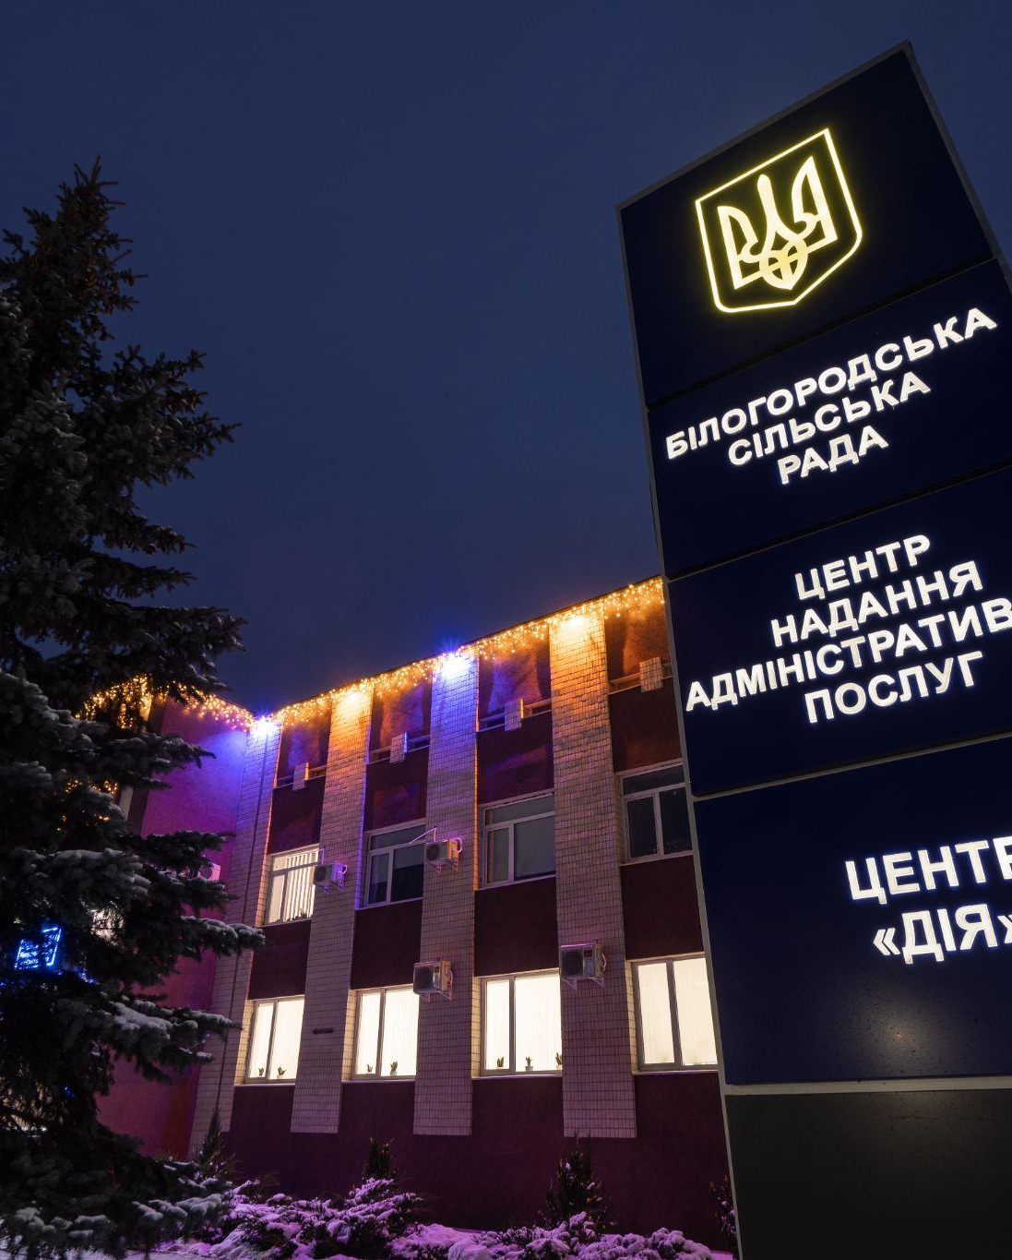
CONTACTS
BILOHORODKA COMMUNITY, Kyiv region,
Ukraine, 2023
+38 067 457 20 37
bilogorod.rada@gmail.com
https://bilohorodka.org.ua
https://www.facebook.com/groups/bilohorodka
08140, Kyiv region, Bucha district, Bilohorodka village, 33 Volodymyrska str.

