Slide 1
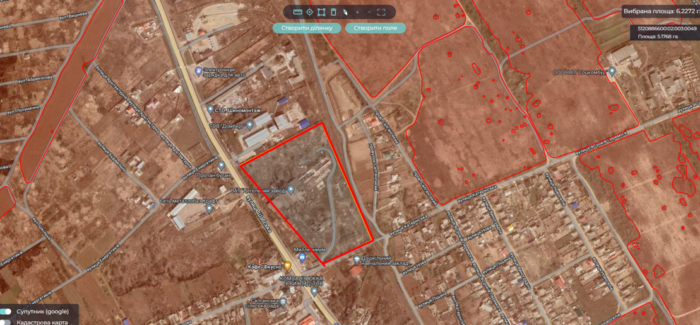
Shabo rural territorial community
Location
Transportation
Odesa region, Shabo rural territorial community
Salgany village
In borders of settlement
To the railway station Shabo- 1 km
To the district center – 2 km
To the regional center – 80 km
To the international highway which connects neighboring states – 15 km
Access to the railroad
Road with hard surface
Property
Location of the plot for manufacturing purposes
Municipal property
Terms of transfer - rent
Short description of the building
Project purpose
Date of building: 1972
2 stored building
Manufacturing area: 6000 square meters
Additional storage facilities: 1000 sq.m
For industrial production
Area
5,17 hectares
Planned types of work
Reconstruction/overhaul of a property plant or building of a new one
Technical infrastructure
Electricity, water supply and sewerage system are available

Slide 2
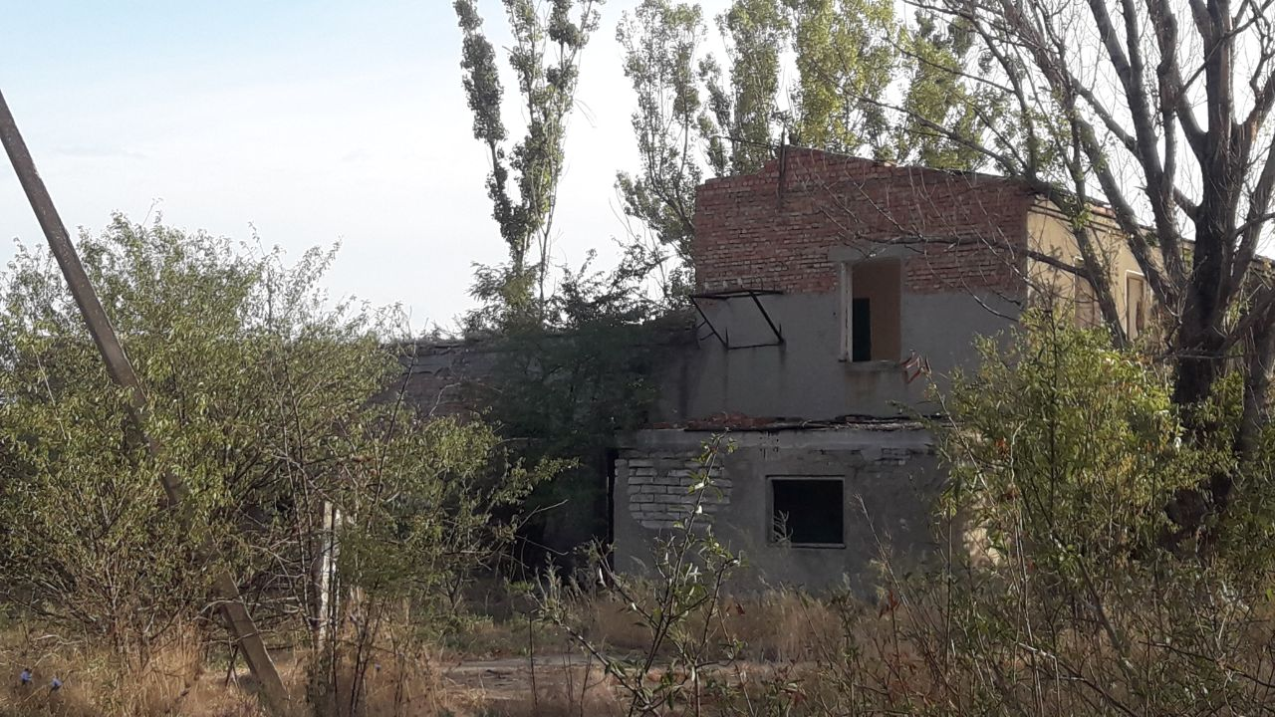
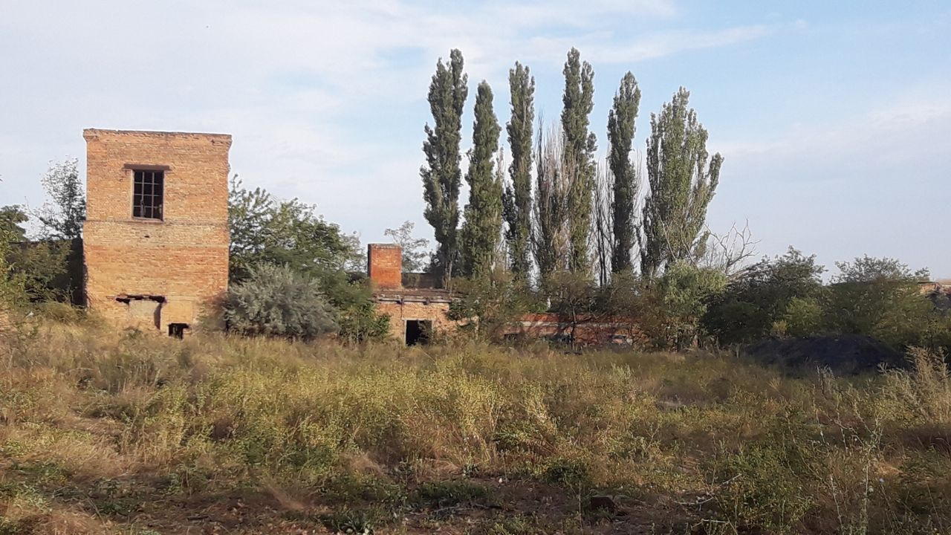
Project initiator
Shabo rural territorial community
Shabo village council
Population: 16 872 people
Community area: 631 sq.km
Project advantages
Support of the village council in the implementation of the project
Privileges for investor: benefits for plot renting
Buildings for industrial production
Funding sources
International and state investments, community funding
Social and economic effect
Attraction of investments
Creating of new working places
Increasing the competitiveness of the community

