Slide 1
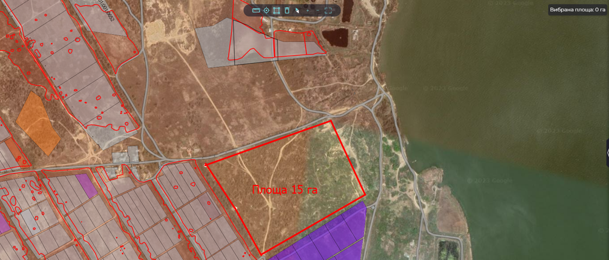
Location
Project initiator
Shabo rural territorial community
Odesa district, Shabo rural territorial community
Salgany village
In borders of settlement
Shabo village council
Population: 16 872 people
Community area: 631 sq.km
Project advantages
Land plot for the construction of the industrial park
Support of the village council in the implementation of the project
Privileges for investor: benefits for plot renting
Transportation
Up to the border of the residential zone – 0,3 km
To railway station Shabo - 2 km
To the district regional center – 2 km
To the regional center – 80 km
To the international highway connecting neighboring states – 15 km
Property
Municipal property
Terms of transfer - rent
Funding sources
International and state investments, community funding
Area
15 hectares
Social and economic effect
Project purpose
Attraction of investments
Creating of new working places
Increasing the competitiveness of the community
Development of scientific, production and market infrastructure
To create an industrial park, placement of buildings and structures of the processing industry
Technical infrastructure
To the gas pipeline – 0,2 km
To the power line (voltage 10 kW) – 0,1 km
To the water supply – 0,1 km
To the point of drainage – 0,5 km
To fiber optic networks – 0,1 km

Slide 2
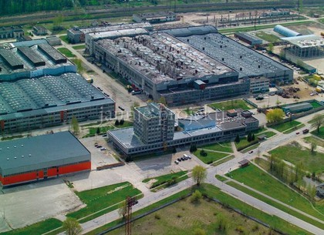
Shabo rural territorial community
Shabo territorial community invites investors to create an industrial park on the territory of the community. Today, in wartime conditions, the industrial park is a key tool for business relocation. The creation of an industrial park is aimed at developing the processing industry, supporting Ukrainian exports, creating new jobs and filling the local budget.
We invite you to join our ambitious project - the construction of an industrial park, which promises to become a key center of industrial development and to bring significant profits for investors. The industrial park is not just a place where companies can engage in production, it is an infrastructure platform for innovation and entrepreneurship.
Our plot of land is located in a strategic location with excellent transport accessibility, which makes it an ideal location for the construction of an industrial park. We have carefully created the development plan and have all the necessary permits to start construction. The park will be equipped with modern infrastructure, including communications, energy supply and logistics solutions.
Investors will have a unique opportunity to receive stable income through the rent or sale of premises and land plots in the industrial park. Our project will contribute to the creation of new jobs, the development of innovative industries and the support of the local economy.
Join us and together we will build the industrial park of the future that will benefit investors, businesses and the community. This is the time when industrial development is combined with sustainability and innovation.

