Slide 1






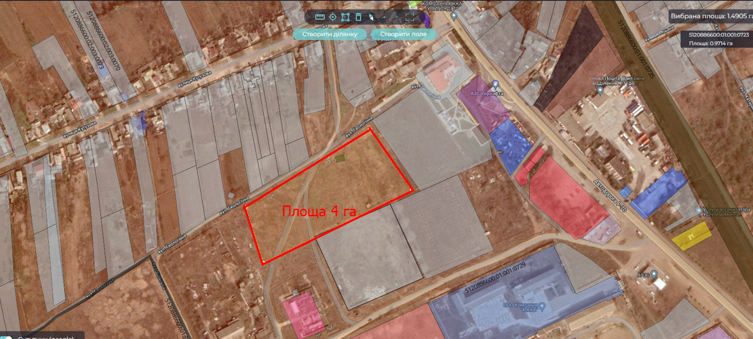




Location
Project initiator
Shabo rural territorial community
Odesa region, Shabo rural territorial community
Salgany village
In borders of settlement
Shabo village council
Population: 16 872 people
Community area: 631 sq.km
Project advantages
Support of the village council in the implementation of the project
Privileges for investor: benefits for plot renting
Transportation
Land plot for the processing industry
Up to the border of the residential zone – 0,1 km
To railway station Shabo - 2 km
To district center – 2 km
To regional center – 80 km
To the national highway – 0,5 km
To the international state highway – 20 km
Availability of an access road with a dirt surface
Property
Municipal property
Terms of transfer - rent
Area
Funding sources
4 hectares
International and state investments, community funding
Social and economic effect
Project purpose
For the placement of buildings and structures of the processing industry
Attraction of investments
Creating of new working places
Increasing the competitiveness of the community
Technical infrastructure
To the gas pipeline – 2,5 km away
To the power line – 0,5 km
To the water supply – 0,3 km

Slide 2
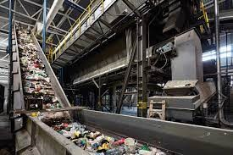
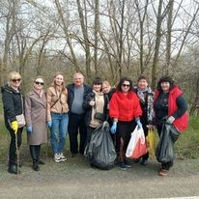
Shabo rural territorial community
We are pleased to present to you a unique investment opportunity in the field of environmental sustainability and profitability - the construction of a waste processing enterprise. Today, when the issues of waste and conservation of natural resources are becoming more and more urgent, our project has a huge potential not only from an ecological, but also from a financial point of view.
Our idea is to create a modern waste processing plant, supplied with advanced technologies and equipment. We plan to use different types of waste and recycle them into secondary resources such as plastic, paper, glass and metal. This process will reduce the amount of garbage that ends up in landfills and will contribute to the preservation of natural resources.
However, our project is not only environmentally beneficial, but also very profitable. According to the latest data, the demand for secondary resources is growing, and we plan to create a stable source of income through their sale on the market. In addition, we have great potential to expand and improve our recycling processes, which will allow us to take a leading position in this field.
We invite you to become our investor and jointly implement this important project. Your investment will not only bring profit, but also help preserve the environment for future generations. Let's be together in this important work that contributes to the preservation of our planet and ensures stable financial growth.

