Slide 1
PROJECT
"Reconstruction of the gynecological department into the Center for Rehabilitation of Children and Persons with Disabilities, Affected by War, in ShabO village council"
27 Tsentralna Str., Shabo village, Bilhorod-Dnistrovskyi district, Odesa region
Building area - 582 sq.m.
The period of project implementation is 9 months
Population - 16132 people, including 1321 internally displaced persons
The main project goal is to create conditions for reducing and overcoming physical, mental, intellectual and sensory disabilities of people with special needs
The estimated project cost is 20,000,000 UAH

Slide 2
Reconstruction of the gynecological department into the Center for Rehabilitation of Children and Persons with Disabilities, Affected by War, in Shabо village council
IMPORTANCE OF PROJECT IMPLEMENTATION
In case of one-floor building reconstruction of the gynecological department, it will be possible to accommodate up to 30 people daily with day stays and 90 people with rehabilitation measures, and create 14 new job places. The center will provide a full range of rehabilitation services: medical, social, physical, and psychological.
The project includes a full renovation of the buildings, which are currently vacant but not suitable for providing the appropriate level of care. It will also include the purchase of rehabilitation equipment.
THE MAIN TASKS OF THE PROJECT:
1. Creating conditions for eliminating restrictions on the vital activity of children and persons with disabilities, restoring and compensating for their impaired or lost abilities to engage in domestic, professional, social activities and integration into society.
2. Implementation of a comprehensive rehabilitation model that will allow to focus not only on the physical characteristics of each person, but also to provide psychological assistance, help in socialization and even make steps in professional preferences.

Slide 3
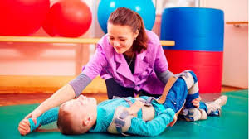
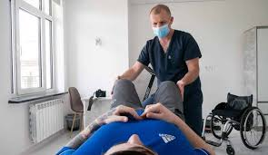
The main task of the community is to improve the quality of life of Ukrainian children and persons with disabilities through comprehensive rehabilitation and creating opportunities for their socialization and the prospect of an independent future.
We offer you a unique opportunity to join an important project - the creation of a rehabilitation center. Our goal is to provide the best specialist care and support for people in need of physical, psychological and social rehabilitation. This project will not only bring great investment satisfaction, but will also have a significant social impact on our society.
Our rehabilitation center will be located in a calm and green place, where patients will be able to recover their health in a natural environment. We have a team of highly qualified professionals and advanced equipment to provide the best rehabilitation care.
Investing in the Rehabilitation center is an opportunity to get a stable income and at the same time do good for others, helping people to restore their health and quality of life. Together we can make this world a better place for everyone and support those who need it most. Join our project and become the part of this important way to improve the lives of many people.

